Slide 1
Chapter 5
SAMPLING AND PROBABILITY

Slide 2
Random Sample
Every member of the population has an equal chance of being selected into the study

Slide 3
Random Sample
Population consists of 50 individuals
Sample N=10
Excerpt from a Random Numbers Table
04493 | 52494 | 75246 | 33824 | 45862
00549 | 97654 | 64501 | 88159 | 96119
35963 | 15307 | 26898 | 09354 | 33351
59808 | 08391 | 45427 | 26842 | 83609

Slide 4
Random Sample
Population consists of 50 individuals
Sample N=10
Excerpt from a Random Numbers Table
04493 | 52494 | 75246 | 33824 | 45862
00549 | 97654 | 64501 | 88159 | 96119
35963 | 15307 | 26898 | 09354 | 33351
59808 | 08391 | 45427 | 26842 | 83609
04, 07, 24, 26, 31, 35, 42, 45, 49, 50

Slide 5
Convenience Sample
Uses participants who are readily available

Slide 6
Random Assignment
Do not confuse with random sampling
Random sampling refers to the method used to create a sample from a population
Random assignment refers to the method of assigning participants to IV levels

Slide 7
Inferential Statistics
Descriptive statistics summarize a sample
Probability allows us to apply what we’ve learned from the sample to the larger population
How?

Slide 8
Inferential Statistics
Step 1. Develop hypotheses
Null Hypothesis
  No difference between populations, or
  Difference is in a direction opposite from that anticipated by the researcher
Research (Alternative) Hypothesis
  There is a difference between populations, or
  There is a difference in a certain direction (pos. or neg.)

Slide 9
Inferential Statistics
Step 1. Develop hypotheses
Null Hypothesis
  Mean calorie estimate is the same for both populations
Research (Alternative) Hypothesis
  Calorie estimate for those viewing the photo with the healthy crackers is different from the calorie estimate for those viewing the photo without the healthy crackers

Slide 10
Null Hypothesis Statistical Testing (NHST)
We are always testing the Null Hypothesis
If the Null Hypothesis is true, how likely is it that we would see a difference in our samples?
Depending on the data collected from our samples, we can
  Reject the Null Hypothesis, or
  Fail to reject the Null Hypothesis

Slide 11
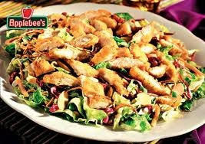

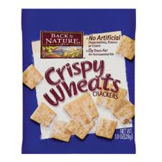
Participants estimated this meal to be 1011 calories (true calorie count = 934)
Participants estimated this meal to be 835 calories (true calorie count = 1034)
Tierney (2008) rejected the Null Hypothesis.

Slide 12
We could be wrong……
Type I Errors
  Rejecting the null hypothesis when the null hypothesis is true
  Saying that something happened when it didn’t
Type II Errors
  Failing to reject the null hypothesis when the null hypothesis is false
  Saying that nothing happened when it did

Slide 13
 | Null Hypothesis is True | Null Hypothesis is False
Reject Null Hypothesis | TYPE I ERROR | CORRECT!
Fail to reject Null Hypothesis | CORRECT! | TYPE II ERROR

